Slide 1
Types of Ciphers

Slide 2
Types of Ciphers
Substitution ciphers involve replacing each member of the plaintext with another member which can be of the same set.
Transposition ciphers are those forms of ciphers that work on the principle of shifting the positions of the characters of the plaintext to create the ciphertext.

Slide 3
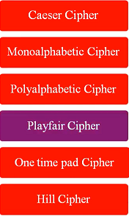
Substitution Ciphers
Vigenere Cipher
Substitution Cipher Techniques

Slide 4
Substitution Techniques
A substitution technique is one in which the letters of plaintext are replaced by other letters or by numbers or by symbols.
Caesar Cipher
Multiplicative Cipher

Slide 5
Caeser Cipher
The Caesar cipher is a simple encryption technique that was used by Julius Caesar to send secret messages to his allies.
It works by shifting the letters in the plaintext message by a certain number of positions, known as the “shift” or “key”.

Slide 6
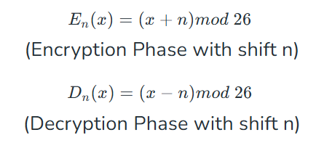
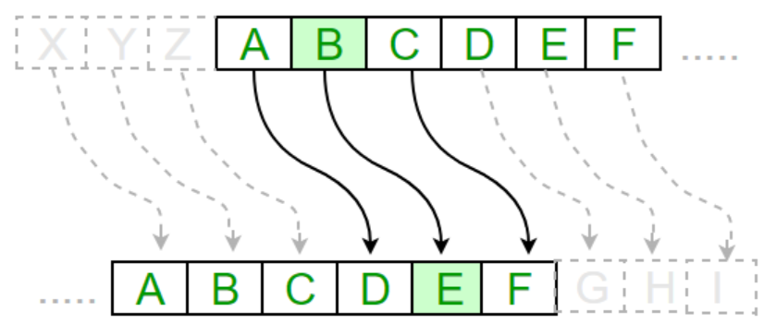
Caeser Cipher
Where n takes on a vale in the range 1 to 25

Slide 7
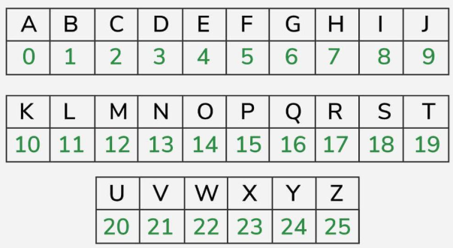
Caeser Cipher

Slide 8
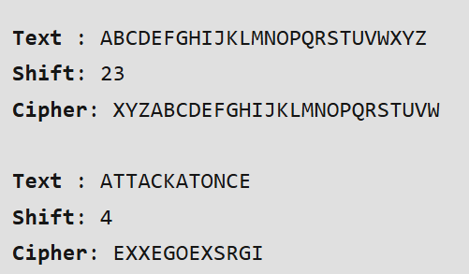
Caeser Cipher

Slide 9
Multiplicative Cipher
use a large prime number as a multiplication key, and then use the modular arithmetic of the integers modulo, the key to encode and decode
The encryption process is done by multiplying the numerical value of each letter in the plaintext by the key and then taking the result modulo the key.
For example, if the key is 7 and the plaintext letter is ‘s’, the numerical value of ‘s’ is 18. So the ciphertext letter is (18*7) mod 26 = 22, and the cipher text symbol will be ‘w’ for the letter ‘a in
this case. the plaintext.
Formula:
C = (P * K) Mod 26 (total number of alphabets)
Here,
C = Cipher text
P = Plain text
K = Key
Mod = Modulus

Slide 10
Choose a Key
Step 1
Choose a key between 1 and 26
Let us choose 9
Gcd(9,26)=1
Step 2
Encrypt “hello”
Each character in the message is multiplied with the key mod 26
Say (7*9) mod 26=11(l)
(4*9) mod 26=10(k)
(11*9) mod 26=21(v)
(11*9) mod 26=21(v)
(14*9) mod 26 =22(w)

Slide 11
Multiplicative Cipher
The decryption process is simply the reverse of the encryption process, i.e., by dividing the numerical value of each letter in the ciphertext by key and then taking the result modulo of the key.
Cipher text is lkvvw
Take each character of cipher text and multiply with the inverse
(P * K⁻¹) Mod 26
Multiplicative inverse is determined using extended Euclidean algorithm

Slide 12
Modular Multiplicative inverse
A modular multiplicative inverse of an integer a is an integer x such that the product ax is congruent to 1 with respect to the modulus m
a x Ξ 1 mod m
x is the modular multiplicative inverse
Example: 3 x Ξ 1 mod 17
Can be written as 3 x mod 17 =1

Slide 13
Modular Multiplicative inverse
Find modular multiplicative inverse using Extended Euclidean Algorithm
5 x Ξ 1 mod 14 find x?
x is the modular multiplicative inverse
Example: 3 x Ξ 1 mod 17
Can be written as 3 x mod 17 =1
If gcd is 1 we can find multiplicative inverse
Gcd(5,14) is 1

Slide 14
Multiplicative Cipher
it is not a secure method of encryption and can be easily broken too. It is suitable for small-scale applications but not recommended for practical purposes.

Slide 15
Multi alphabet Substitution Cipher
- Playfair Cipher

Slide 16
Playfair Cipher
The best-known multiple-letter encryption cipher is the Playfair, which treats digrams in the plaintext as single units and translates these units into ciphertext digrams.
The Playfair algorithm is based on the use of a 5 x 5 matrix of letters constructed using a keyword.

Slide 17
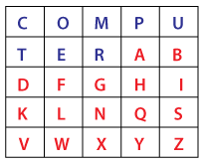
Playfair Cipher
Step 1 – Choose a Key
Let us assume the key is COMPUTER
STEP 2 – Construct the 5X5 Matrix
S
C
O
P
E
A
B
D
F
G
H
I/J
K
L
M
N
Q
R
T
U
V
W
X
Y
Z

Slide 18
Playfair Cipher
Step 3 – Choose a Message for Encryption – COMMUNICATE
Rule 1 - Repeating plaintext letters that are in the same pair are separated with a filler letter, such as x, so that balloon would be treated as ba lx lo on.
COMMUNICATE
CO MX MU NI CA TE

Slide 19
Playfair Cipher - Encryption
S
C
O
P
E
A
B
D
F
G
H
I/J
K
L
M
N
Q
R
T
U
V
W
X
Y
Z
CO MX MU NI CA TE
OM RM PC SG PT ER
Two plaintext letters that fall in the same column are each replaced by the letter beneath, with the top element of the column circularly following the last.
Otherwise, each plaintext letter in a pair is replaced by the letter that lies in its own row and the column occupied by the other plaintext letter
Two plaintext letters that fall in the same row of the matrix are each replaced by the letter to the right, with the first element of the row circularly following the last

Slide 20
Playfair Cipher –DECRYPTION
S
C
O
P
E
A
B
D
F
G
H
I/J
K
L
M
N
Q
R
T
U
V
W
X
Y
Z
OM RM PC SG PT ER
CO MX MU NI CA TE

Slide 21
Playfair Cipher
The Playfair cipher is a great advance over simple monoalphabetic ciphers. For one thing, whereas there are only 26 letters, there are 26 x 26 = 676 digrams, so that identification of individual digrams is more difficult.
Furthermore, the relative frequencies of individual letters exhibit a much greater range than that of digrams, making frequency analysis much more difficult.
For these reasons, the Playfair cipher was for a long time considered unbreakable.
It was used as the standard field system by the British Army in World War I and still enjoyed considerable use by the U.S. Army and other Allied forces during World War II.
Despite this level of confidence in its security, the Playfair cipher is relatively easy to break because it still leave much of the structure of the plaintext language intact. A few hundred letters of ciphertext are generally sufficient.

Slide 22
Vigenere Cipher

Slide 23

Polyalphabetic Substitution
The same plaintext letter is not always encrypted to the same cipher text letter in polyalphabetic substitution

Slide 24
Vigenere Cipher
The cipher was first described by Giovan Battista Bellaso in 1553.
The cipher is easy to understand and implement, but it resisted all attempts to break it until 1863, three centuries later.

Slide 25
Vigenere Cipher
STEP 1 Select a Message to Encrypt
Message – “AWESOME”
Step 2 - Select a key
Key – VIT
Step 3 – Expand the Key
A | W | E | S | O | M | E
V | I | T | V | I | T | V

Slide 26
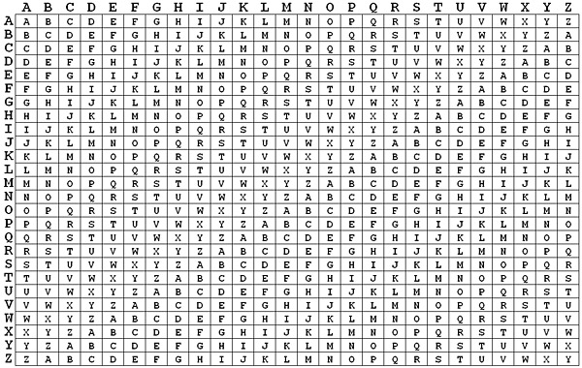
STEP 4
A | W | E | S | O | M | E
V | I | T | V | I | T | V
V
E
X
N
W
F
Z

Slide 27
N | I | M | D | A | A
N | I | M | D | A | A
V | I | T
V | E | X | N | W | F | Z
V | I | T | V | I | T | V
A | W | E | S | O | M | E

Slide 28
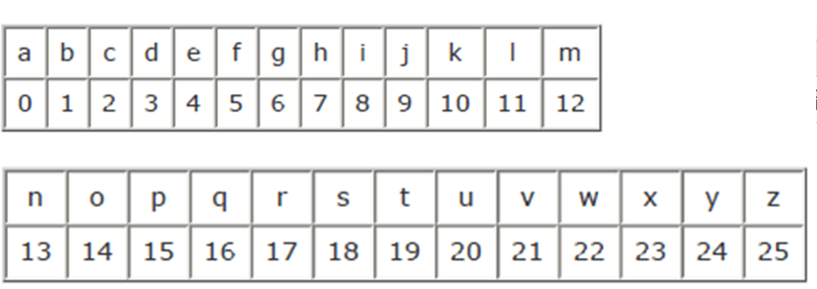
Algebraic Representation of Vigenere Cipher
Encryption using the Key K
C_{i} = (M_{i} + K_{i})mod 26
Decryption using the Key K
M_{i} = (C_{i} - K_{i}+26) mod 26

Slide 29
Encryption
A | W | E | S | O | M | E
V | I | T | V | I | T | V
Message is AWESOME
C_{i} = (M_{i} + K_{i})mod 26
C₁ = (M₁ + K₁)mod 26

Slide 30
V | E | X | N | W | F | Z
V | I | T | V | I | T | V
M_{i} = (C_{i} - K_{i}+26) mod 26

